Slide 1
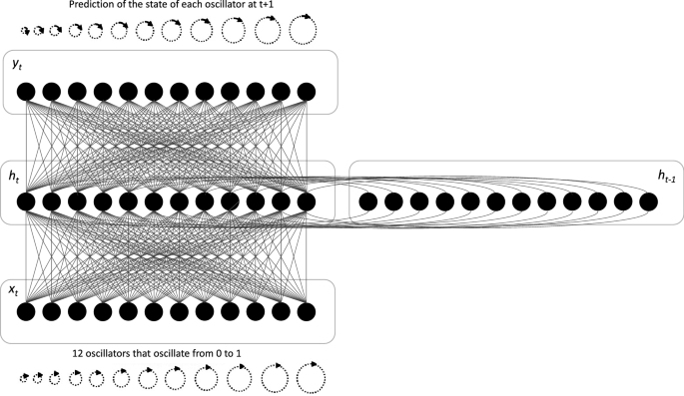
SYSTEMS THEORY FRAMEWORK
Temporal Dissonance, Cognitive Drift, and the Prevention of Irreversible Disease
A Systems Framework for Understanding and Preventing Alzheimer's Disease Through Temporal-Cognitive Dynamics
April 2026
Academic Research Presentation

Slide 2
1.1
The Core Problem: Why Prevention Has Failed
The Paradox of Current Research
The Central Thesis
Alzheimer's research has focused almost exclusively on biological pathology—amyloid plaques, tau tangles, neurofibrillary degeneration—that appears late in the disease process.
Time is not a background abstraction. It is an active field that shapes cognition, memory consolidation, and neural stability.
By the time these markers are detectable, the system has already crossed into irreversibility. The upstream causes remain unaddressed.
Temporal dissonance—the sustained mismatch between externally imposed time structures and endogenous biological rhythms—is the causal driver of cognitive drift.
The Missing Variable
Alzheimer's is preventable by detecting and correcting temporal dissonance before the recovery gradient collapses.
What if the primary driver of cognitive decline is not biological but temporal? What if time itself functions as a physiological field, and prolonged dissonance between imposed and natural rhythms produces the drift that precedes all pathology?
Key Insight
Dementia precedes Alzheimer's not as a prodromal stage, but as a warning signal—a recoverable drift state that, if left uncorrected, crosses a phase transition into irreversible disease.

Slide 3
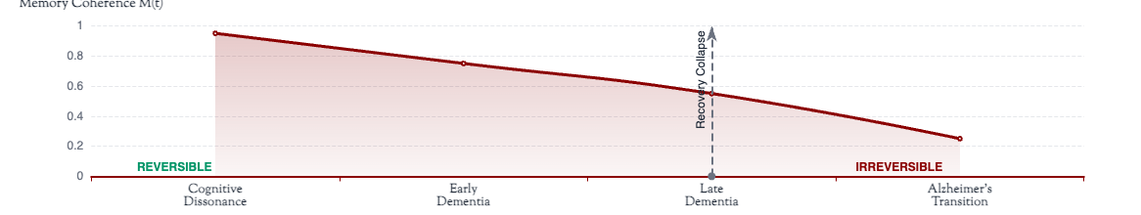
1.2
The Three-State Model: A New Classification
1
Cognitive Dissonance
2
Dementia
3
Alzheimer's
Pre-Dementia Stage
Drift State
Phase Transition
Definition: Sustained internal conflict arising from temporal overload and schedule pressure.
Definition: Persistent temporal drift producing gradual degradation of memory coherence.
Definition: Loss of recoverability—collapse of the recovery gradient.
Characteristics: Monkey mind, attention fragmentation, subjective time compression.
Characteristics: Fluctuating coherence, observable recovery when restoration available.
Characteristics: Monotonic decline, no rebound after rest, biological pathology emerges.
Recoverability:Fully reversible through environmental correction.
Recoverability:Recoverable while restoration capacity (ξ) remains.
Recoverability:Irreversible within current system architecture.
System State Progression

Slide 4
2.1
Time as a Physiological Field
Reframing Time
Time is conventionally treated as a neutral background against which biological processes unfold. This framework proposes a fundamental reframing: time functions as a physiological field—an active structure that shapes cognition, memory consolidation, and neural stability.
The Governing Equation
dM/dt = −λ|T(t) − Tnatural| + ξ
Just as electromagnetic fields influence charged particles, temporal fields influence cognitive coherence. The structure of time—its rhythm, pacing, and alignment with biological rhythms—directly determines system stability.
M(t): Memory coherence at time t
λ: Drift sensitivity coefficient
T(t): Imposed temporal field
Tnatural: Endogenous temporal field
Two Temporal Fields
ξ: Restorative capacity
Natural Time (Endogenous)
Circadian rhythms, ultradian cycles, biological pacing. Self-regulated, coherent, restorative.
Temporal Dissonance
Extracted Time (Imposed)
Defined as the absolute mismatch between imposed and natural temporal fields:
Schedules, deadlines, interruptions, external demands. Fragmented, compressive, extractive.
D(t) = |T(t) − Tnatural|
Sustained dissonance produces cognitive drift; restoration counteracts it.

Slide 5
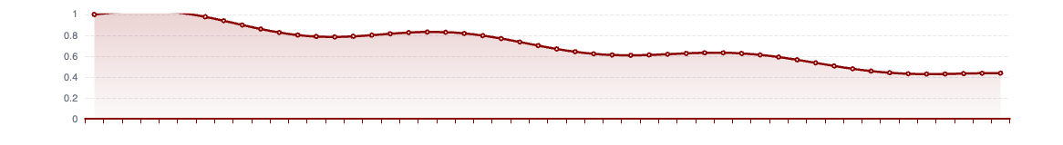
3.1
From Dissonance to Drift: The Dementia State
Defining Temporal Drift
Drift Metrics
Temporal drift is the gradual, cumulative degradation of memory coherence produced by sustained temporal dissonance. It is not sudden collapse but progressive instability.
Temporal Drift Index (TDI)
Drift emerges when the restorative capacity (ξ) is insufficient to fully counteract the extraction pressure (λD), producing net negative change in coherence over time.
TDI = D(t) / ξ — ratio of extraction to restoration
Persistence Measure (P)
Dementia as Drift State
Fraction of time TDI > 1 (drift dominates)
Dementia is reclassified not as a terminal disease endpoint but as a recoverable drift state characterized by:
Recovery Gradient
Capacity to rebound after stress period
• Fluctuating memory coherence (not monotonic decline)
• Observable recovery when restoration is available
• Dynamic instability, not fixed impairment
The Preventive Window
Dementia represents the final reliable prevention window. While in this state, restoration can still reverse drift. Once recovery gradient collapses, the transition to irreversibility becomes inevitable.
Temporal Drift Simulation: Coherence Over Time

Slide 6
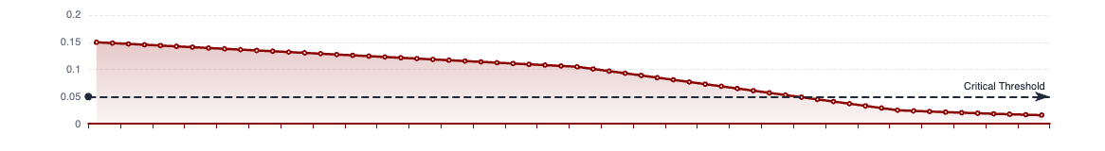
4.1
The Alzheimer's Transition: Loss of Recoverability
Alzheimer's as Phase Transition
Why Alzheimer's Is Irreversible
Alzheimer's is not gradual worsening of dementia. It is a phase transition—an abrupt qualitative change in system behavior when a critical threshold is crossed.
1. Structural Collapse: The system has reorganized into a new attractor state where decline is self-sustaining.
The defining variable is not symptom severity but loss of recoverability. Once the recovery gradient collapses, the system cannot return to its previous state, regardless of subsequent intervention.
2. Recovery Gradient Collapse: The capacity to rebound from stress has been exhausted.
3. Pathology as Downstream Effect: Biological markers (plaques, tangles) emerge as consequences, not causes, of the collapsed state.
Formal Definition
The Point of No Return
The Alzheimer's transition occurs when:
Operationally defined as the point where:
limt→∞ dM/dt < 0 AND ξ < λD(t) ∀ t > tc
Recovery Gradient < 0.05 AND Slope < 0
Where tc is the critical transition time.
Beyond this threshold, temporal re-alignment can slow decline but cannot restore prior coherence.
Phase Transition: Recovery Gradient Collapse

Slide 7

5.1
Prevention Through Temporal Re-Alignment
Prevention Follows From Definition
Temporal Re-Alignment
From the established premises, prevention is not speculative—it is logically determined:
Definition: Reduction of imposed temporal extraction and restoration of endogenous temporal control.
Temporal dissonance is the causal driver of cognitive drift.
Dementia is a recoverable drift state.
Alzheimer's begins when recoverability collapses.
System Effects:
• Recovery windows lengthen
Therefore: Prevention consists of maintaining recoverability by correcting the causal variable.
• Memory consolidation resumes
• Cognitive punishment loops unwind
• Attention stabilizes
What Prevention Means
• Drift slows or reverses
Prevention does not mean suppressing symptoms, compensating for deficits, or intervening after pathology appears.
The Restoration Condition
Prevention means:
ξ ≥ λ|T(t) − Tnatural|
Interrupting temporal drift before recovery gradient collapses
When restoration equals or exceeds extraction, coherence stabilizes. This is the fundamental equation of prevention.
Timing of Intervention: Effectiveness Window

Slide 8
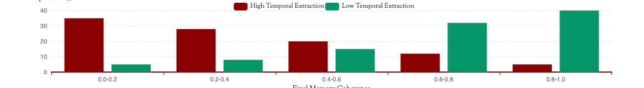
6.1
Simulation Evidence and System Validation
Purpose of Simulation
Key Simulation Results
The framework's claims are demonstrated through explicit, executable simulations—not illustrative metaphors but system tests.
Dementia Emergence:
Prolonged dissonance produces gradual M(t) decline; recovery remains observable; coherence fluctuates.
All simulations share: identical governing equation, controlled temporal inputs, explicit restoration parameters, no hidden variables.
Alzheimer's Transition:
Simulation Suite Overview
Monotonic decline appears only when recovery windows vanish; transition is abrupt.
Prevention Demonstrated:
Category A — Drift Formation: Continuous vs. natural vs. mixed temporal regimes
Temporal re-alignment before recovery collapse stabilizes coherence and halts decline.
Category B — Recovery: Late-stage restoration, threshold escalation, individual variance
Early Detection:
Category C — Environment: Institutional temporal load, home vs. institution comparison
TDI identifies sustained temporal dominance before functional impairment.
Category D — Detection: Early drift index, population outcomes, policy effects
Validation Summary
✓ Temporal dissonance causes drift
✓ Dementia is recoverable drift
✓ Alzheimer's requires loss of recoverability
✓ Prevention operates by restoring temporal equilibrium
Population-Level Simulation: Outcome Distribution

Slide 9
7.1
The Full Detection–Prevention Stack
1
Cognitive Dissonance
2
Dementia
3
Alzheimer's Transition
Layer 1 — Pre-Dementia
Layer 2 — Drift State
Layer 3 — Phase Transition
Detection Target:
Detection Target:
Detection Target:
Sustained internal conflict and temporal overload
Persistent temporal drift with recovery gradient present
Loss of recoverability, recovery gradient collapse
Indicators:
Indicators:
Indicators:
Monkey Mind instability, attention fragmentation, subjective time compression
TDI > 0, fluctuating coherence, observable recovery
P > 0.6, slope < 0, recovery < 0.05
Intervention:
Intervention:
Intervention:
Temporal re-alignment, restoration of autonomy
Limited—can slow but not reverse
Environmental correction, schedule reduction
Outcome: Reversal Possible
Outcome: Structural Limit
Outcome: Complete Prevention
Primary Prevention Window
Beyond Recovery Boundary
Continuous Monitoring System
These layers form a continuous monitoring system, not a one-off diagnosis. Early detection at Layer 1 enables complete prevention. Detection at Layer 2 enables reversal. Detection at Layer 3 marks the boundary beyond which structural recovery fails.
Why This Framework Resolves Failures
Practical Implications
• Explains why biological pathology appears late
• Dementia should trigger temporal assessment
• Explains why symptom-focused approaches fail
• Early dissonance should trigger environmental correction
• Explains why outcomes vary under similar conditions
• Care environments evaluated for temporal extraction
• Explains why institutional environments worsen decline
• Prevention measured by recovery gradients

Slide 10
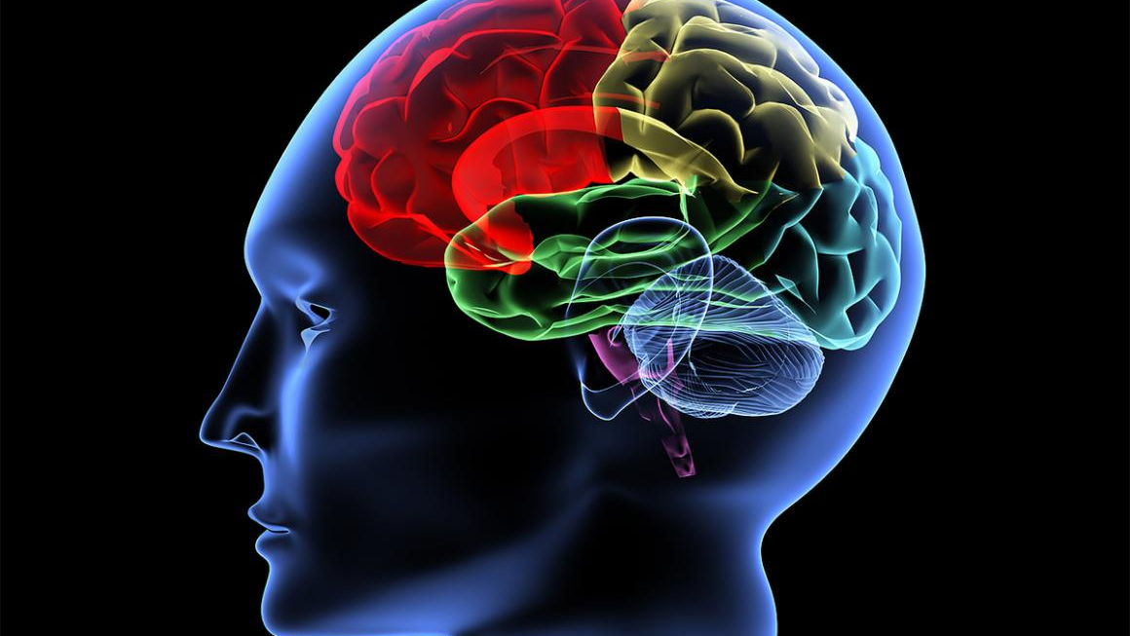
SYNTHESIS AND PATH FORWARD
Alzheimer's Is Not Inevitable
The conclusion of this framework is explicit:
Alzheimer's is the consequence of prolonged temporal dissonance left uncorrected. Detecting and correcting that dissonance early preserves recoverability and prevents disease.
Dementia Is the Warning
Time Is the Cause
Restoration Is the Solution
A recoverable drift state signaling system instability
Temporal dissonance drives cognitive drift
Temporal re-alignment prevents transition
What This Framework Enables
Early-Warning Systems: Design detection protocols for cognitive dissonance before dementia develops
Temporal-Health Simulations: Model population outcomes under different temporal regime policies
Environment Evaluation: Assess care facilities, workplaces, and institutions for cognitive harm
Prevention at Scale: Block progression to Alzheimer's where dementia already exists

