Slide 1

NAVIGATION ARCHITECTURE
NashMark AI Nav
Ambiguity-Sensitive Continuity and Drift Recovery in Navigation
Equilibrium-Governed Model
Label-Light Traversal
Degraded Signal Recovery

Slide 2
EXECUTIVE SUMMARY
Core Proposition
Fundamental Shift
Key Capabilities
NashMark AI begins from the premise that navigation is a continuity problem under uncertainty, not merely a point-estimation challenge. The system must preserve coherent traversal when observations are incomplete, distorted, delayed, or structurally ambiguous.
1
Preserve State Coherence
Maintain lawful traversal under uncertainty
2
Resist False Collapse
Avoid premature commitment to wrong states
3
Restore After Drift
Benchmark Position
Recover from degraded observations
Conventional Kalman filtering remains strongest in clean labelled-route tracking. HMM-style models retain value in discrete branch-state interpretation. NashMark AI shows its clearest advantages in ambiguity-sensitive continuity, drift recovery, and degraded traversal conditions, where equilibrium preservation matters more than immediate local correction.
4
Defer Unsafe Commitment
Wait for structural confidence
Narrow but Defensible Claim: NashMark AI is a viable navigation and recovery architecture with strongest current evidence in ambiguous, degraded, and continuity-sensitive environments.
Target Environments
Deep-sea traversal
Urban canyons
GNSS dropouts
Orbital blackout

Slide 3

PART I
Mathematical
Foundation
The theoretical framework governing equilibrium-based navigation

Slide 4
CHAPTER 1 — 2
Navigation as Continuity, Not Mere Fix Estimation
Conventional Approach
Latent Path Inference
Most navigation systems are constructed as recursive estimators. They attempt to infer latent state from noisy observations through prediction and correction. This is effective when:
Let the latent traversal state at step t be defined over a candidate set of route states. A probabilistic inference layer assigns likelihood over those states rather than forcing immediate collapse.
Observation stream remains sufficiently stable
δt(j) = maxi[δt-1(i) + log aij] + log bj(t)
Environment is well-behaved estimation problem
where aij is transition structure, bj(t) is observation likelihood
NashMark Position
Γt = { j : γt(j) ≥ τ }
Corridor retention threshold τ maintains structured ambiguity
Treats navigation as preservation of lawful traversal under uncertainty. The system should:
Preserve Coherence
Resist Collapse
Maintain state consistency
Avoid false state transitions
"Under degraded observation, the system does not have to collapse instantly to one route edge or one path label. It can retain structured ambiguity while remaining traversally coherent."
Restore After Drift
Defer Commitment
Recover equilibrium
Wait for confidence

Slide 5
CHAPTER 3 — 4
Equilibrium as Governing Principle
Net Traversal Imbalance
Governance Stability
Δt = Destabilising Load − Stabilising Structure
Navigation under uncertainty is not only a probability problem—it is a decision-governance problem. A model that commits too fast can fail structurally even when local evidence looks strong.
Equilibrium when: Δt = 0
G(t) = wcC̄(t) + wpP(t) − wvV(t)
Destabilising
Stabilising
C̄(t)
P(t)
V(t)
Avg. cooperation
Policy alignment
Volatility
• Observation drift
• State coherence
• Structural ambiguity
• Governance stability
Key Insight: The model asks not merely which state is most likely, but whether the system is sufficiently governed to commit safely.
• Breach pressure
• Route continuity
• Inconsistency
• Restoration potential
Recovery & Degradation Curves
Safe Operating Envelope
The model represents not merely current state, but expected recovery capacity and residual degradation pressure over time—essential in tunnel, dropout, drift, or ambiguity-heavy settings.
MSS(t) = C(t) / (C(t) + D(t))
Moral/Structural Stability
R(t) = E* − e−kt
Recovery potential over time
Rsys(t) = wdd(t) + wvV(t)
Dh(t) = D0e−λt
Systemic Risk
Degradation intensity decay
Safe Conditions:
MSS(t) ≥ θM AND Rsys(t) ≤ θR

Slide 6
CHAPTER 5 — 6
Governance Stability and Safe Operating Envelope
The Governance Layer
Gating Logic
A model that commits too fast can fail structurally even when its local evidence looks strong. NashMark introduces a governance layer that prevents premature state transitions.
Branch commitment, transition hardening, and aggressive restoration are gated by lawful state, not by raw probability alone.
1
Check MSS
Cooperation
Alignment
Volatility
Is moral/structural stability above threshold?
C̄(t)
P(t)
V(t)
2
Check Risk
G(t) = wcC̄(t) + wpP(t) − wvV(t)
Is systemic risk within acceptable bounds?
3
Allow Commit
Safe Operating Envelope
Only then permit hard state transition
The model is constrained by a safe operating envelope. Navigation systems should not be forced into hard commitment when structural conditions are unsafe.
Moral/Structural Stability
Systemic Risk
MSS(t) = C/(C+D)
Rsys(t) = wdd + wvV
Safety First
Must satisfy: MSS(t) ≥ θM
Must satisfy: Rsys(t) ≤ θR
This prevents the system from making irreversible commitments when internal conditions suggest instability.

Slide 7
PART II
Applied Navigation
Architecture
Implementation layers and operational mechanisms

Slide 8
CHAPTER 7 — 9
NashMark AI Architecture Overview
Six-Layer Architecture
Key Distinction
The applied NashMark navigation model is composed of six integrated layers that distinguish it from plain recursive estimators.
The system is not simply asking where the point estimate lies. It is evaluating:
1
Latent Traversal Inference
Coherence
Probabilistic inference over candidate route states
Does current traversal remain structurally coherent?
2
Corridor Retention
Maintain plausible traversal set under uncertainty
Governability
3
Equilibrium Refinement
Is the system sufficiently governed to commit safely?
Inner convergence under live observation
Safety
4
Governance Stability
Is it safe to harden the current state?
Multi-agent convergence assessment
5
Safe-Envelope Gating
MSS and risk threshold enforcement
Live Step Signals
6
Dynamic Restoration
At each step, the system derives key state signals from observations:
Recovery curves and commit control
Pressure
Ambiguity
Stable Obs.
Breach

Slide 9
CHAPTER 10 — 11
Dynamic Gain Modulation and Temporal Commit Gating
Dynamic Gain Modulation
Temporal Commit Gating
NashMark AI does not apply a single fixed correction gain. It modulates the navigation update according to equilibrium state, ambiguity, governance stability, recovery potential, and degradation load.
A single-step dominance spike should not force branch switching. The system requires persistence before hard commitment—a hysteresis mechanism preventing branch flapping.
Commit at t ⇔ Dt ∧ Ct ∧ Gt ∧ Σt
Observation Gain
Dt:
Dominance validity
Ct:
Persistence streak
Controls how strongly live observation pulls current state
Gt:
Governance sufficiency
Σt:
Safe envelope
Target Gain
Controls corridor/route target pull strength
Four Questions Before Commit
Is the candidate genuinely dominant?
Has that dominance persisted?
Is the system governable enough?
Is the system inside safe envelope?
Recovery Gain
Controls restoration toward coherent traversal
Action-State Conditioning
COOPERATE
Behavioral Outcomes
Stronger target and recovery structure
HOLD
Sharp
Cautious
Balanced correction behavior
Stable conditions
Under ambiguity
DEFECT
Increased observation pull, reduced commitment
Restorative
Conservative
Under drift
Under breach

Slide 10
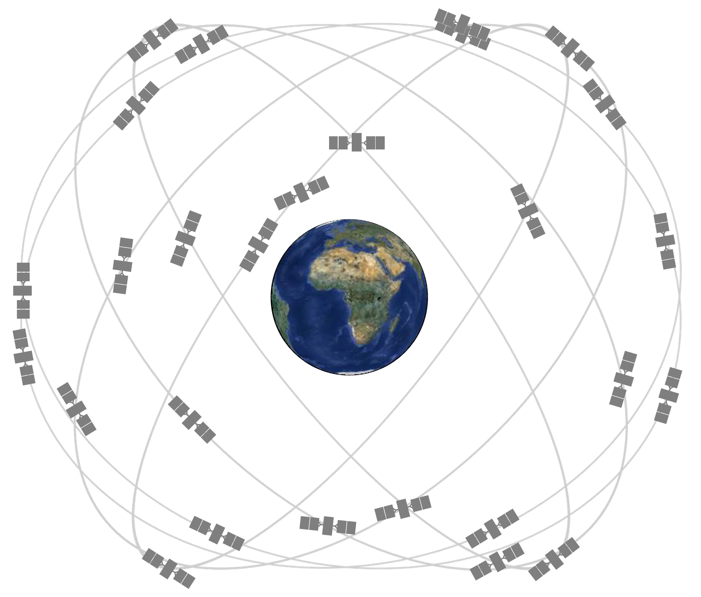
PART III
Benchmark
Results
Empirical validation across five challenging scenarios

Slide 11
CHAPTER 14 — 18
Benchmark Scenarios and Results
Five Test Scenarios
Comparative Results
1
Clean Route
Ambiguous Junction (Key Win)
Best
Benign conditions, baseline performance
Kalman
HMM
NashMark
3.58
5.73
3.08
2
Urban Canyon
Mean Error
Mean Error
Mean Error ✓
Structured distortion, multipath effects
0% false branch commits | 87.7% continuity
3
GNSS Dropout / Tunnel
Drift Recovery (Strong Performance)
Best
Signal absence, blackout conditions
Kalman
HMM
NashMark
4
Ambiguous Junction
1.97
5.88
1.84
Structural ambiguity, branch uncertainty
Mean Error
Mean Error
Mean Error ✓
100% continuity | 100% restoration efficiency
5
Drift Recovery
Severe drift, restoration dynamics
GNSS Dropout / Tunnel
Strong
Kalman
HMM
NashMark
1.60
7.85
2.56
Benchmark Objective
Mean Error
Mean Error
Mean Error
Test whether NashMark AI improves continuity-sensitive traversal under degraded, ambiguous, or drift-heavy conditions relative to conventional baselines.
98.5% continuity | 0% false branch rate
Note: Kalman remains strongest in clean conditions. NashMark excels in degraded/ambiguous scenarios.

Slide 12

Conclusion & Product Direction
Established Claim
Product Architecture
NashMark AI is a benchmarked navigation and recovery architecture with strongest evidence in ambiguity-sensitive continuity and drift-recovery tasks.
• Rooted label authority where available
• Sharp continuous estimator where useful
• NashMark as equilibrium governor
Dual Deployment Modes
Standalone
Governing Layer
Navigation logic in label-light space
Higher-order control around rooted labels
"Product-grade architecture, even if further tuning remains"

